Slide 1
GenAI HW7
Understanding what AI is thinking
TA: 方泓傑、李哲言、白宗民
ntu-gen-ai-2024-spring-ta@googlegroups.com
Deadline: 2024/5/16 23:59:59 (UTC+8)

Slide 2
Outline
Link
Introduction
Task 1: Token Importance Analysis
Task 2: LLM Explanation
Submission & Deadline
Contact
Colab
COOL Quiz
Questions

Slide 3
Introduction

Slide 4
Why should we know what generative AI is thinking?
Correct answer ≠ Intelligent
Explanation is essential in high-stakes applications, e.g., medicine and law.
We can improve our model based on our explanation.
Notes:
Correct answer ≠ Intelligent 正确答案 ≠ 智能
Explanation is essential in high-stakes applications, e.g., medicine and law. 解释在高风险应用中至关重要，例如医学和法律。
We can improve our model based on our explanation. 我们可以根据我们的解释改进我们的模型。

Slide 5
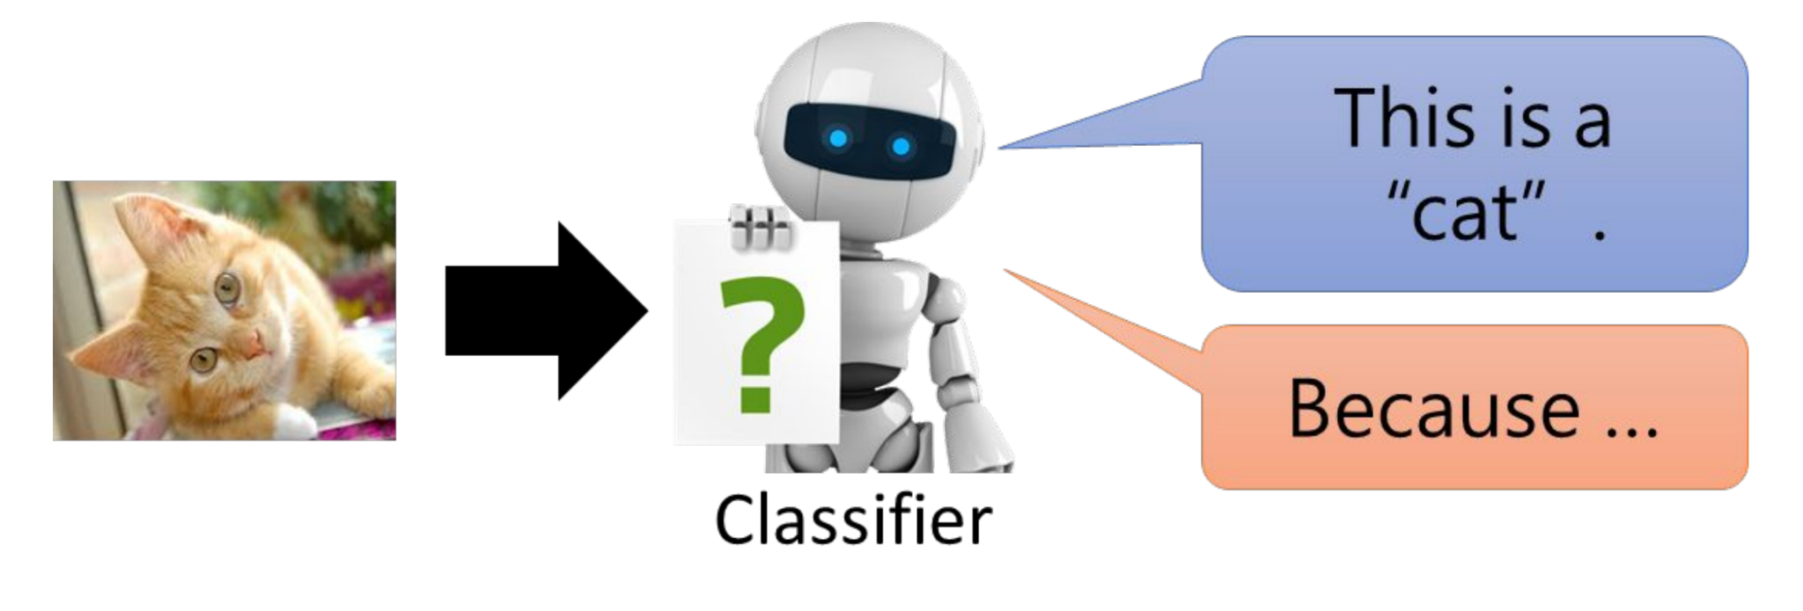
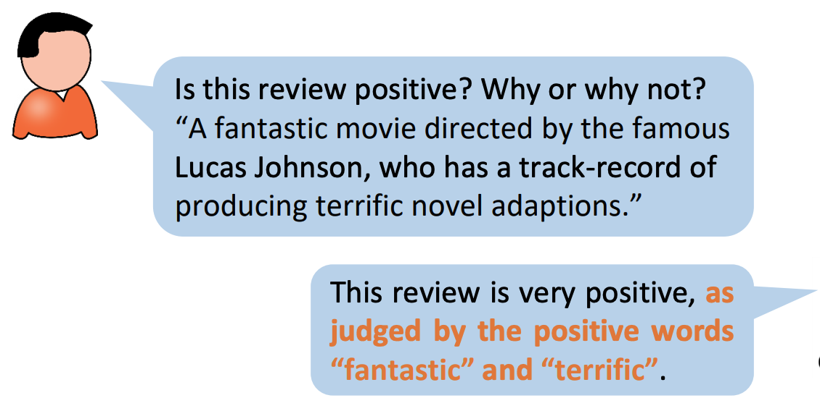

Model Explanation
Image source: 2310.11207.pdf (arxiv.org), Interpreting Neural Network (ntu.edu.tw)

Slide 6
Task 1: Token Importance Analysis
Notes:
Token Importance Analysis 代币重要性分析

Slide 7
Task Description
In this task, we aim to understand what tokens play important roles in generating the response.
We utilize feature attribution methods to analyze the importance.
Gradient-based approach
Attention-mechanism
Run the sample code and finish question 1 to 7.
Notes:
In this task, we aim to understand what tokens play important roles in generating the response. 在这个任务中，我们旨在了解哪些标记在生成响应中起着重要作用。
We utilize feature attribution methods to analyze the importance. 我们利用特征归因方法来分析重要性。
Gradient-based approach 基于梯度的方法
Attention-mechanism 注意机制
Run the sample code and finish question 1 to 7. 运行示例代码并完成问题 1 至 7。

Slide 8
Gradient-based Approach (saliency)
Compute the gradient of the target logit with respect to the input tokens.
logits
The first president of America is
Language Model
1. Calculate Prediction (forward)
a | … | George | … | Zyzzyva
2. Select a logit
3. Backpropagate
George
Image modified from jalammar.github.io
Notes:
Gradient-based Approach (saliency) 基于梯度的方法（显著性）
Compute the gradient of the target logit with respect to the input tokens. 计算目标逻辑相对于输入标记的梯度。

Slide 9
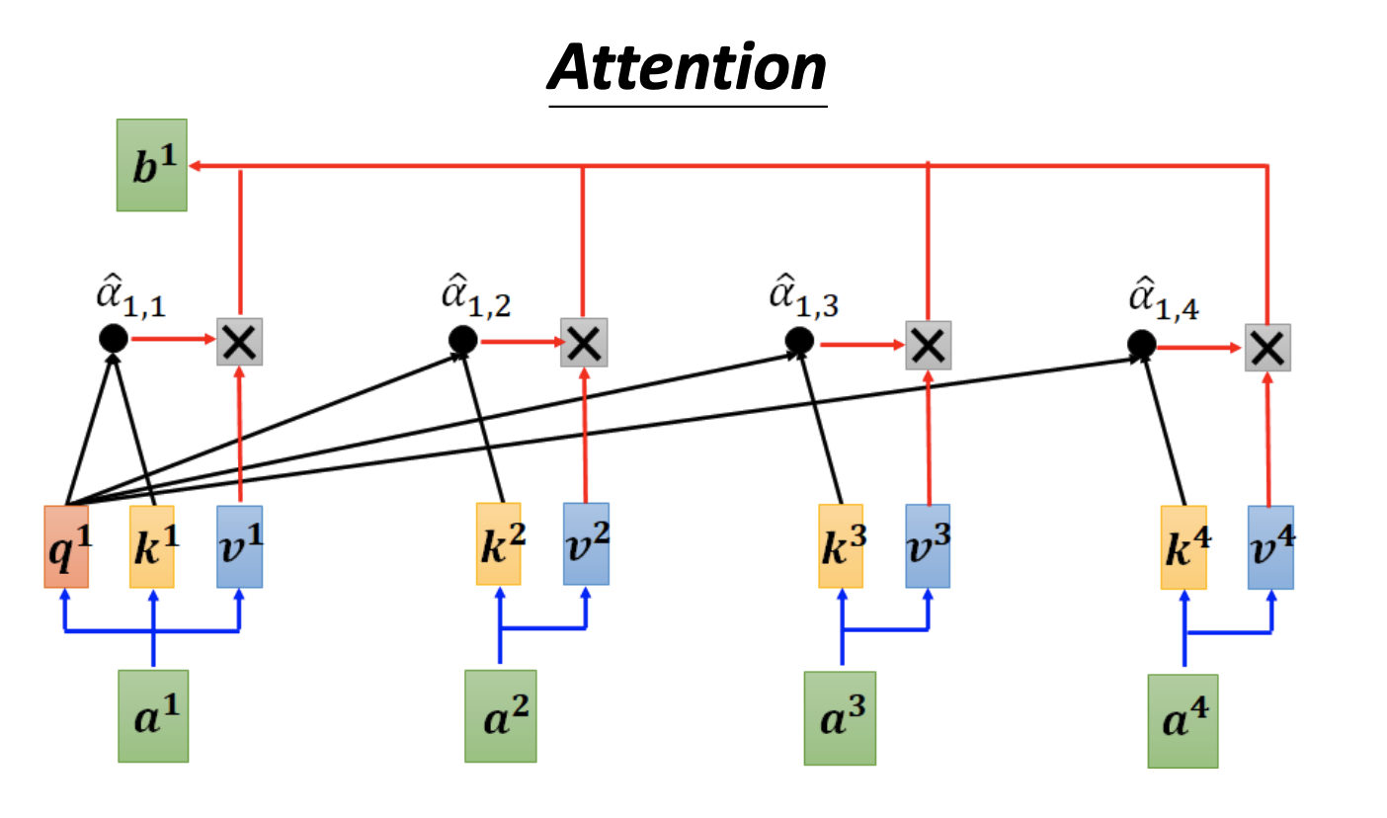
Attention-mechanism
Commonly used in transformer-based models.
Shows which tokens the model attends to when generating the output.
Image source: Interpreting Neural Network (ntu.edu.tw)

Slide 10
Token Visualization
In this task, we use https://github.com/inseq-team/inseq/ to visualize the importance of token when generating the response.
It supports many feature attribution methods, including gradient and attention, which we will use in this homework.

Slide 11
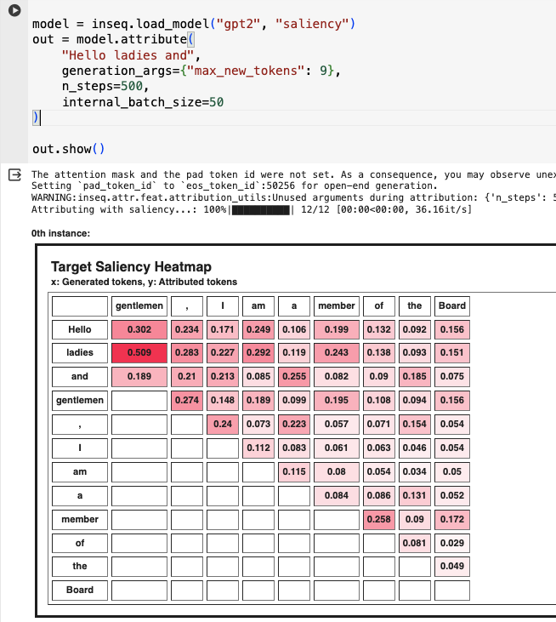
Inseq
model
method
Input

Slide 12
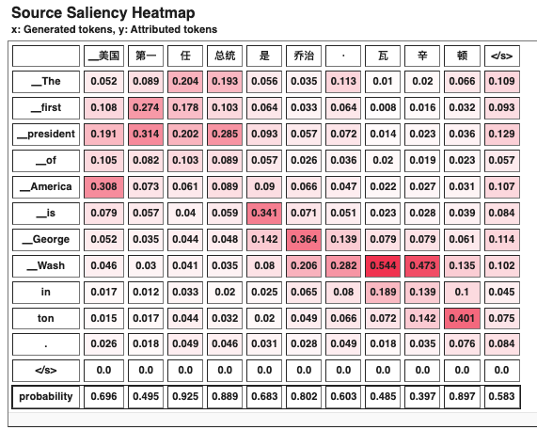
Saliency map of machine translation task
Output
The first president …
Translation Model
Input
美國第一任總統 ...

Slide 13
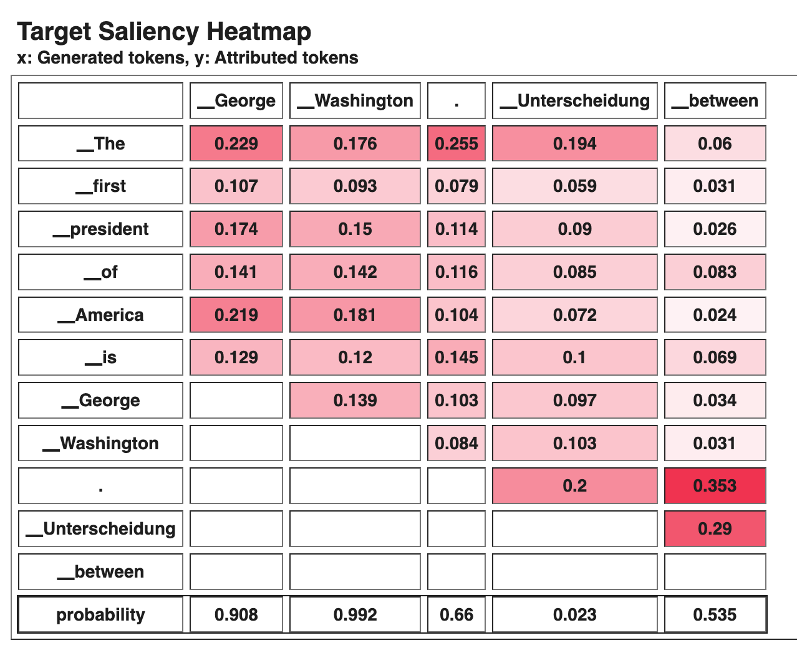
Saliency map of sentence completion task
Generated tokens
The
First
First
President
President
of
of
America
America
is
is
George
George
Input
Autoregressive Model
First
President
of
America
is
George
Washington
Importance score

Slide 14
Example of saliency map
Q: When generating the word “Washington”, what’s the importance score of “America”?
A: 0.181

Slide 15
Task 2: LLM Explanation

Slide 16
LLM Explanation
LLMs have the ability to explain in natural language.
It is much more straightforward to understand than prior methods.
Image source: 2310.11207.pdf (arxiv.org)

Slide 17
Task Description
In this task, we aim to assess the effectiveness of LLM explanation.
We will explore two LLM explanation approaches.
Providing the explanation for the model’s answer.
Simulating the feature attribution method in task 1 to see the importance of tokens.
Run the given prompts on ChatGPT and finish Question 8 to 10. (No need of Colab)

Slide 18
Explain the model’s answer
Directly ask the LLM to explain its answer.
Prompt:
You are a creative and intelligent movie review analyst, whose purpose is to aid in sentiment analysis of movie reviews. Determine whether the review below is positive or negative, and explain your answers.
Review: This film is a compelling drama that captivates audiences with its intricate storytelling and powerful performances.

Slide 19
Simulate feature attribution methods with LLM explanation
Ask the LLM to explain the importance of the input tokens in contributing to the answer, similar to what we do in task 1.
2310.11207.pdf (arxiv.org)

Slide 20
Simulate feature attribution methods with LLM explanation
Prompt:
You are a movie review analyst tasked with sentiment analysis. For each review, provide a list of tuples representing the importance of each word and punctuation, with values ranging from -1 (negative) to 1 (positive). Then, classify the review as positive (1) or negative (-1). The review is within <review> tags.
Example output:
[(<word or punctuation>, <float importance>), ...]
<int classification>
<review> This film is a compelling drama that captivates audiences with its intricate storytelling and powerful performances. <review>
Note: ChatGPT's responses may vary due to randomness. If the format isn't as desired, please try again.
2310.11207.pdf (arxiv.org)

Slide 21
Submission & Deadline

Slide 22
Submission
Finish questions on NTU COOL Quiz
Unlimited times of submissions for the quiz, but only the latest submission will be considered when grading
No late submission is allowed

Slide 23
Important dates
Deadline for Submission (NTU Cool)
2024/05/16 23:59:59 (UTC+8)
Grading Release Date
2024/05/31 23:59:59 (UTC+8)

Slide 24
Contact

Slide 25
If You Have Any Questions
NTU Cool HW7 作業討論區
如果同學的問題不涉及作業答案或隱私，請一律使用NTU Cool 討論區
助教們會優先回答NTU Cool討論區上的問題
Email: ntu-gen-ai-2024-spring-ta@googlegroups.com
Title should start with [GenAI 2024 Spring HW7]
Email with the wrong title will be moved to trash automatically
TA Hours
Time:
5/3, 16:30 ~ 17:20
5/10 13:20~14:10, 16:30 ~ 17:20
Location: 綜合大講堂

